Slide 1




非叶子节点
a
$$\frac{∂y}{∂a}=b=x+2$$
$$\frac{∂a}{∂x}=1$$
+1
叶子节点
x
*
y
非叶子节点
+2
$$\frac{∂b}{∂x}=1$$
$$\frac{∂y}{∂b}=a=x+1$$
非叶子节点
b
b
非叶子节点
叶子节点
a
d
非叶子节点
c
非叶子节点

Slide 2
图1
图2

Slide 3
Generator
Discriminator
Input Z
Fake X
Real/Fake
Real X

Slide 4
Conditioner
True/False
Generator
Input Z
Fake X
Discriminator
Real/Fake
Real X

Slide 5











$$real$$
$$real$$
$$fake$$
$$fake$$
D
D
$$X_{real}$$
$$X_{fake}$$
$$X_{real}$$
$$X_{fake}$$
G
G
$$Z \left(noise\right)$$
$$C \left(label\right)$$
$$Z \left(noise\right)$$
Vanilla GAN
Conditional GAN

Slide 6

















$$real …$$
$$…$$
$$real c=2$$
$$real$$
$$c=2$$
$$real c=1$$
$$fake$$
$$c=1$$
$$fake$$
D/C
D
$$X_{real}$$
$$X_{fake}$$
$$X_{real}$$
$$X_{fake}$$
G
G
$$C \left(label\right)$$
$$Z \left(noise\right)$$
$$C \left(label\right)$$
$$Z \left(noise\right)$$
Auxiliary Classifier GAN
Semi-Supervised GAN

Slide 7
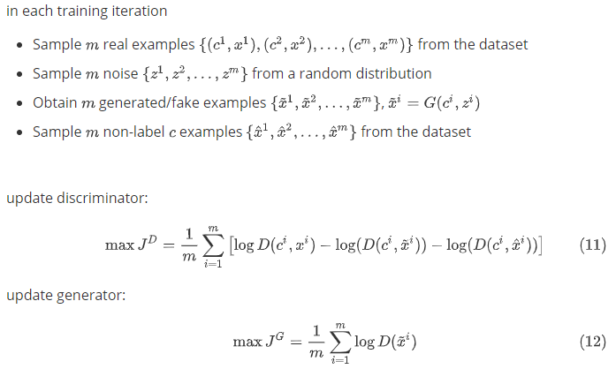




$$real$$
$$true$$
$$fake$$
$$false$$
D
C/F
$$X_{real}$$
$$X_{fake}$$
G
$$Z \left(noise\right)$$
Multi-Objective GAN

Slide 8
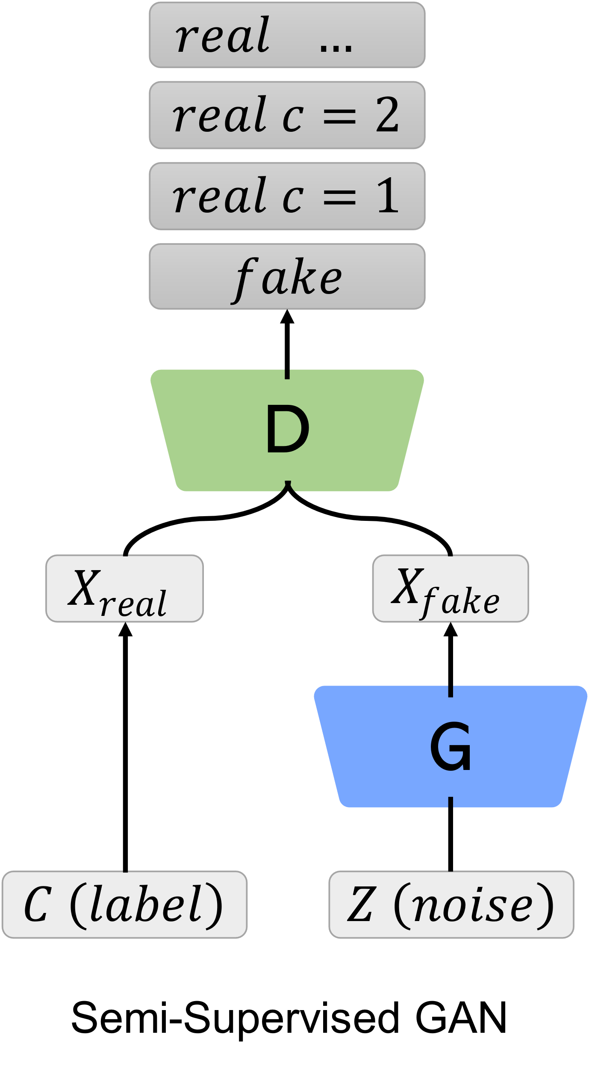
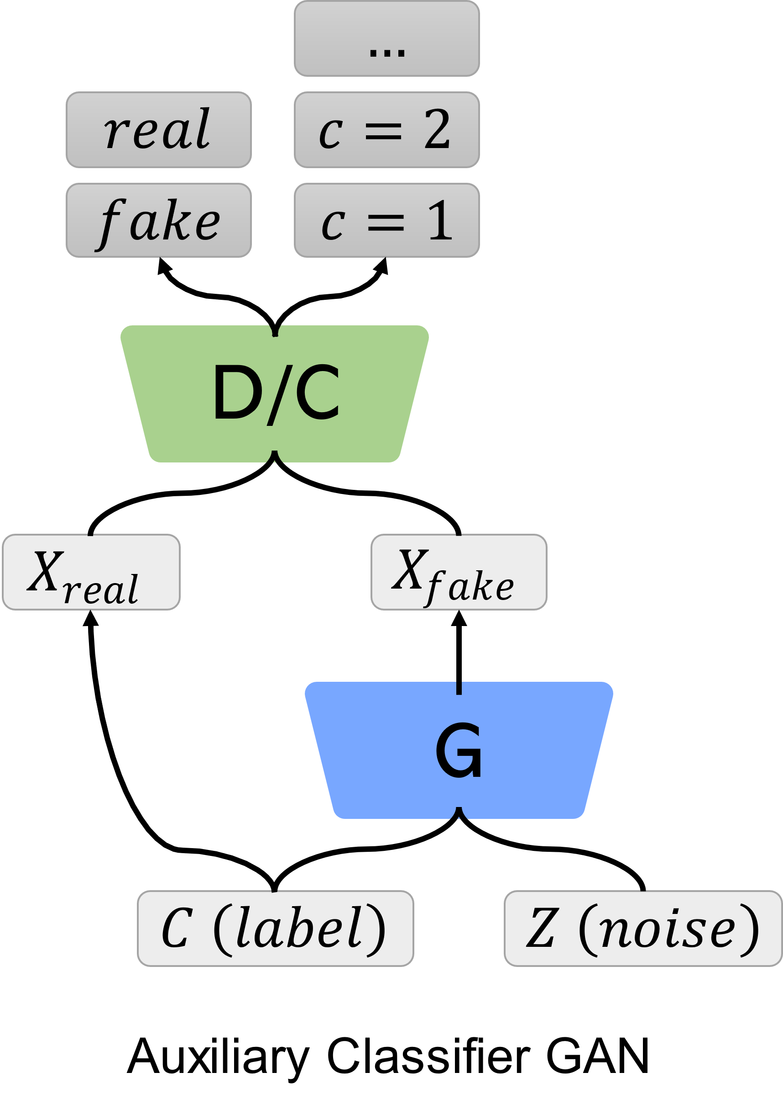
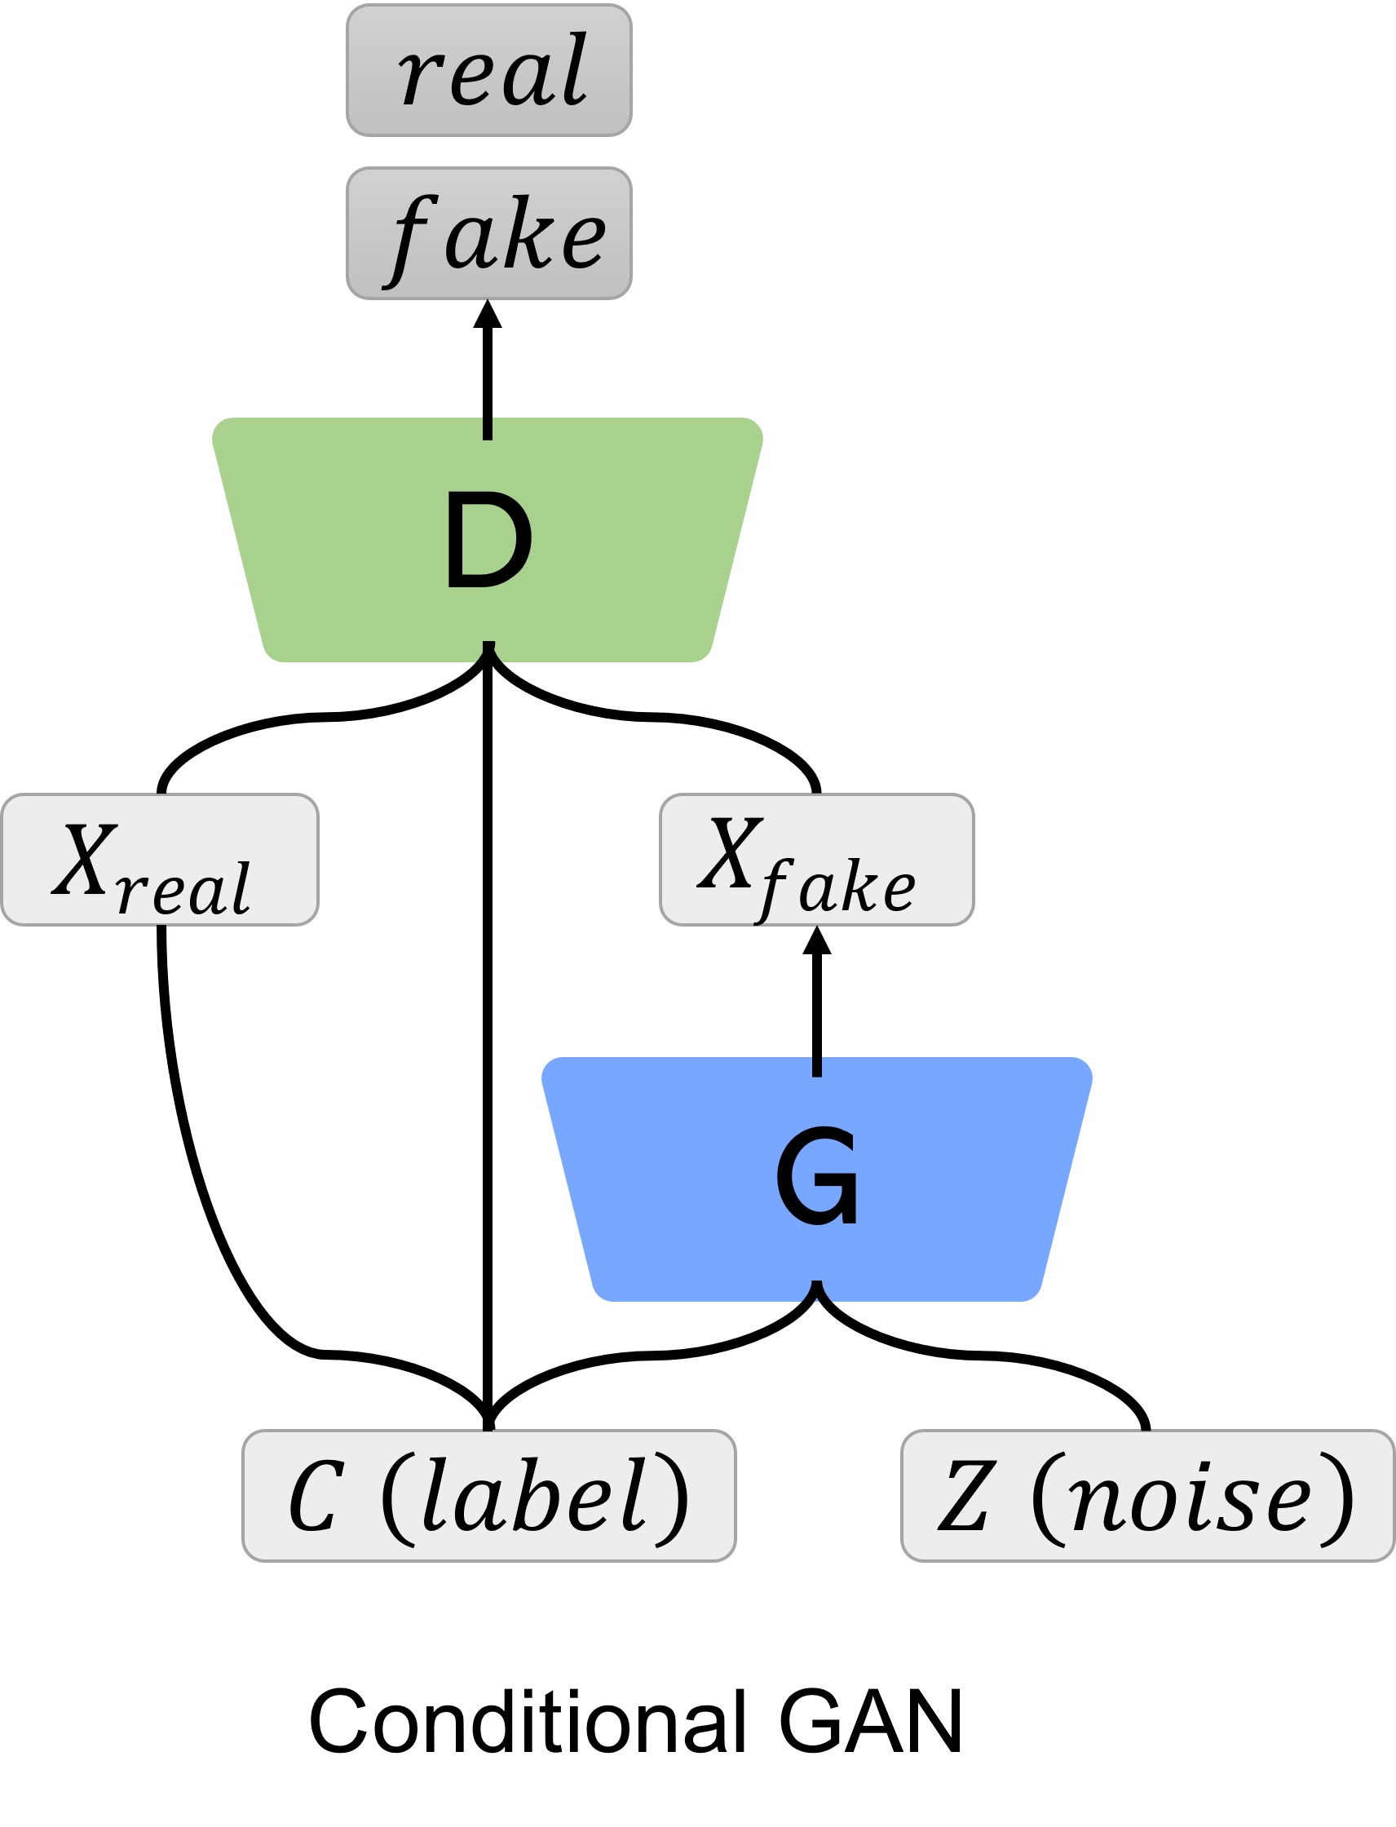
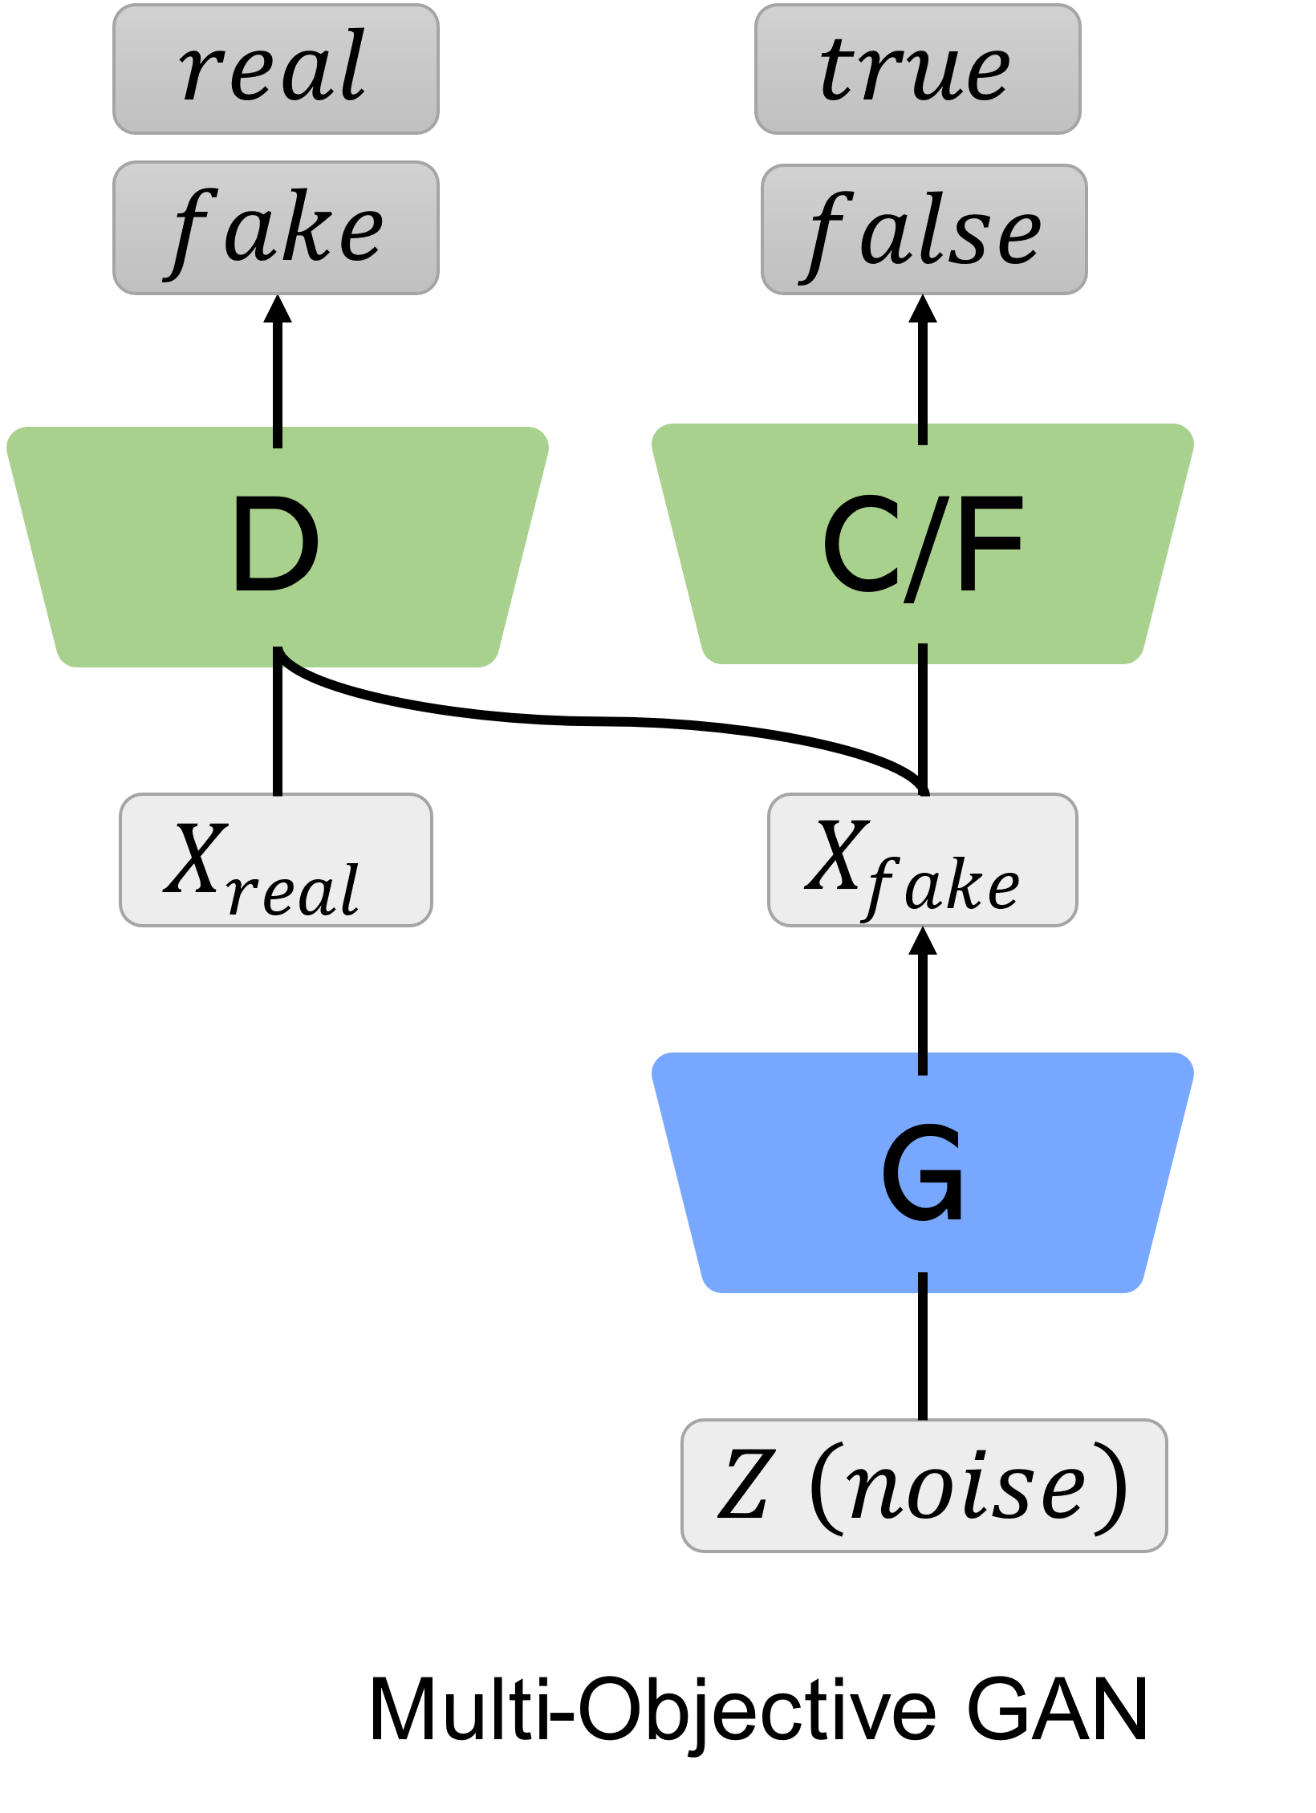

Slide 9



$$f_{2}$$
$$pareto front$$
$$f_{1}$$

Slide 10




$$f_{2}$$
$$λ_{0}^{1..μ}$$
$$λ_{1}^{1..μ}$$
$$λ_{2}^{1..μ}$$
$$λ_{n}^{1..μ}$$
$$pareto front$$
$$f_{1}$$

Slide 11
$$f_{2}$$
$$λ_{0}^{1..μ}$$
$$λ_{1}^{1..μ}$$
$$λ_{2}^{1..μ}$$
$$λ_{n}^{1..μ}$$
$$pareto front$$
$$f_{1}$$

Slide 12







$$g_{1}$$
$$g_{1}$$
$$g_{1}$$
∟
∟
$$g_{2}$$
∟
∟
∟
$$g_{2}$$
$$g_{2}$$
$$g_{3}$$
（1）
（2）

Slide 14
Task 1
Task 2
Task 3
Specific layers
Shared layers

Slide 15
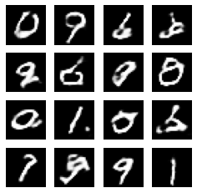
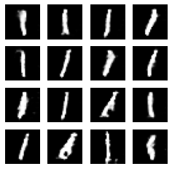


$$\left(a\right)$$
$$\left(b\right)$$

Slide 17
Discriminator

Slide 18




fff
Conditioner
X_real
X_fake
D
True/False
$$X_{fake}$$
G
G
$$X_{real}$$
C (label)
Z (noise)
Real/Fake
G
$$C \left(label\right)$$
$$Z \left(noise\right)$$
CGAN

Slide 19












$$real$$
$$real$$
$$fake$$
$$fake$$
D
D
$$X_{real}$$
$$X_{fake}$$
$$X_{real}$$
$$X_{fake}$$
G
G
$$C \left(label\right)$$
$$Z \left(noise\right)$$
$$C \left(label\right)$$
$$Z \left(noise\right)$$
Conditional GAN

Slide 20
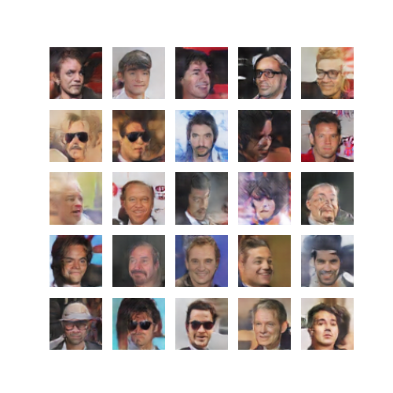
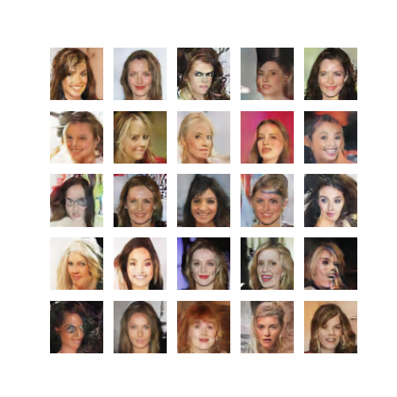
male
female

Slide 21
2 month
Literature Survey
WP1
Decomposition
4 month
Gradient-based method
5 month
WP2
Two-phase method
4 month
Gradient-based method
3 month
Theoretical Analysis
4 month
λ-method
3 month
WP3
Learning optimal structure
4 month
Recommendation system
3 month
WP4
Antenna design
3 month
Final Report
1 m
0
2
6
11
15
18
22
25
29
32
36

Slide 22
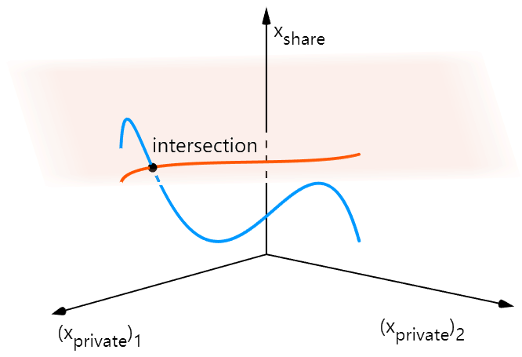
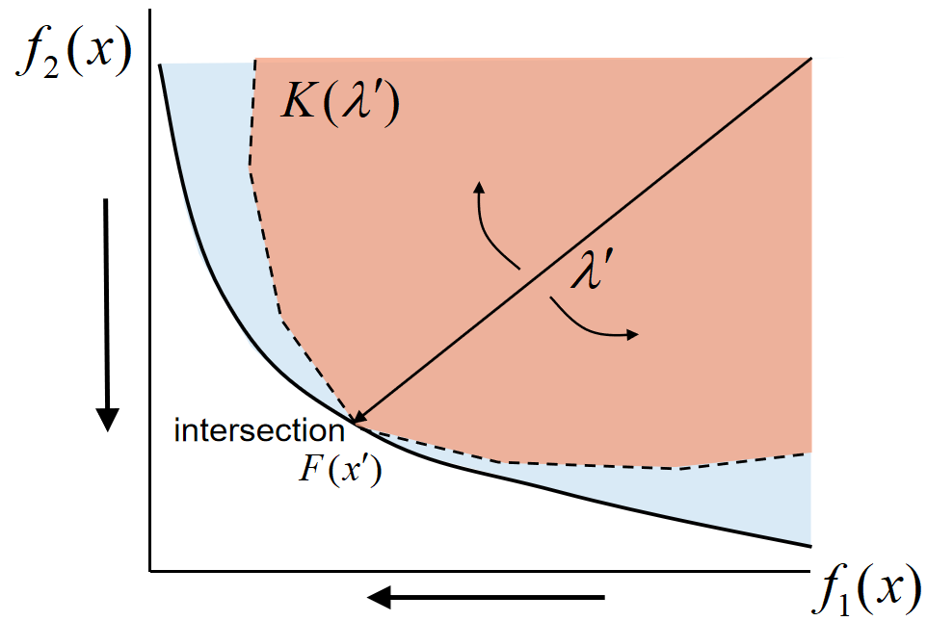

Slide 23

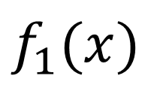

$$f_{2}(x)$$
$$\tilde{λ}$$
$$f_{1}(x)$$

Slide 24

$$f_{2}(x)$$
$$\tilde{λ}$$
$$f_{1}(x)$$

Slide 25

$$f_{2}(x)$$
$$\tilde{λ}$$
$$f_{1}(x)$$

Slide 26

$$f_{2}(x)$$
$$\tilde{λ}$$
$$f_{1}(x)$$

